Slide 1
Html And Html5
SlideMake.com

Slide 2
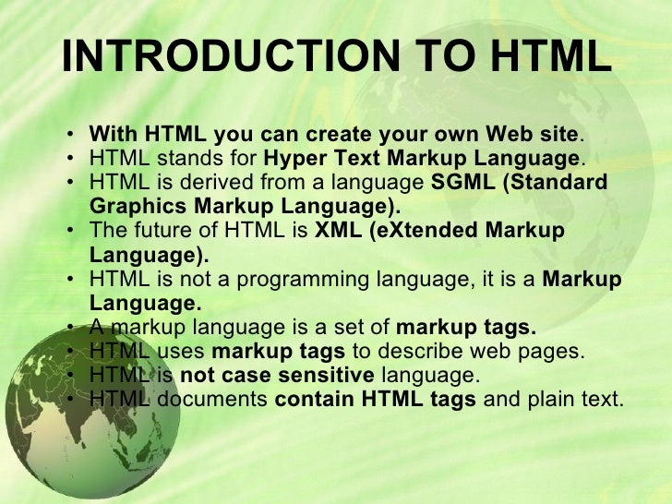
Introduction to HTML
HTML stands for Hypertext Markup Language.
It is the standard markup language for creating web pages.
HTML tags are used to structure content on the web.
Notes:
Image source: http://www.slideshare.net/vikasgaur31/introduction-to-html-9088114

Slide 3
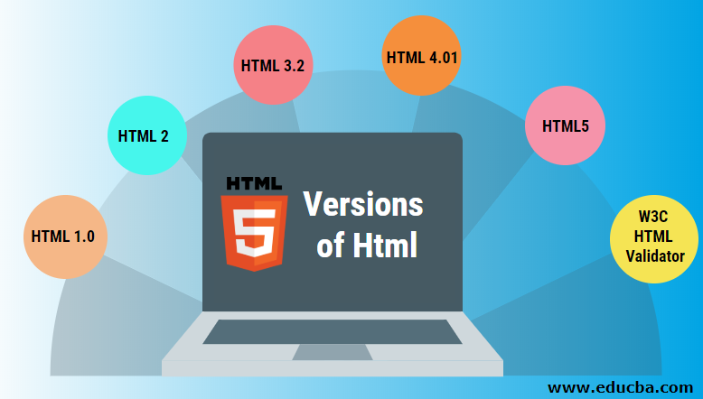
Evolution of HTML
HTML5 is the latest version of HTML.
It introduced new elements and attributes for enhanced web development.
HTML5 offers better support for multimedia content like audio and video.
Notes:
Image source: https://laptopprocessors.ru/different-version-of-html/

Slide 4
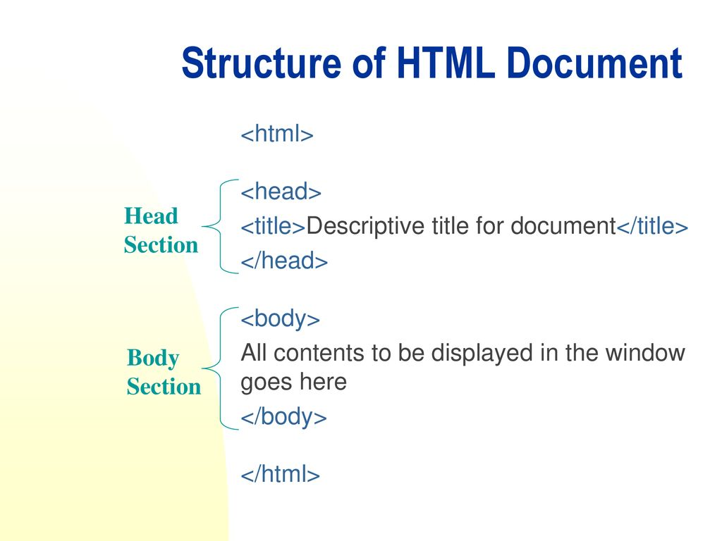
Structure of an HTML Document
An HTML document consists of elements enclosed in tags.
The <html> tag defines the document structure.
The <body> tag contains the main content of the webpage.
Notes:
Image source: https://www.bartleby.com/subject/engineering/computer-science/concepts/elements-and-tags

Slide 5
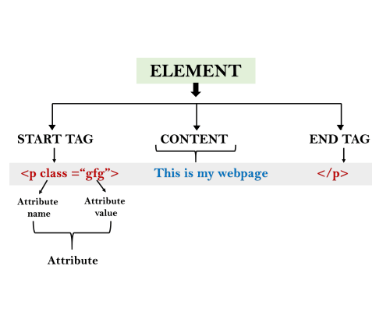
HTML Elements
HTML elements are the building blocks of a webpage.
Elements can have attributes that provide additional information.
Examples of elements include <p> for paragraphs and <img> for images.
Notes:
Image source: https://yashoda.hashnode.dev/html-elements

Slide 6
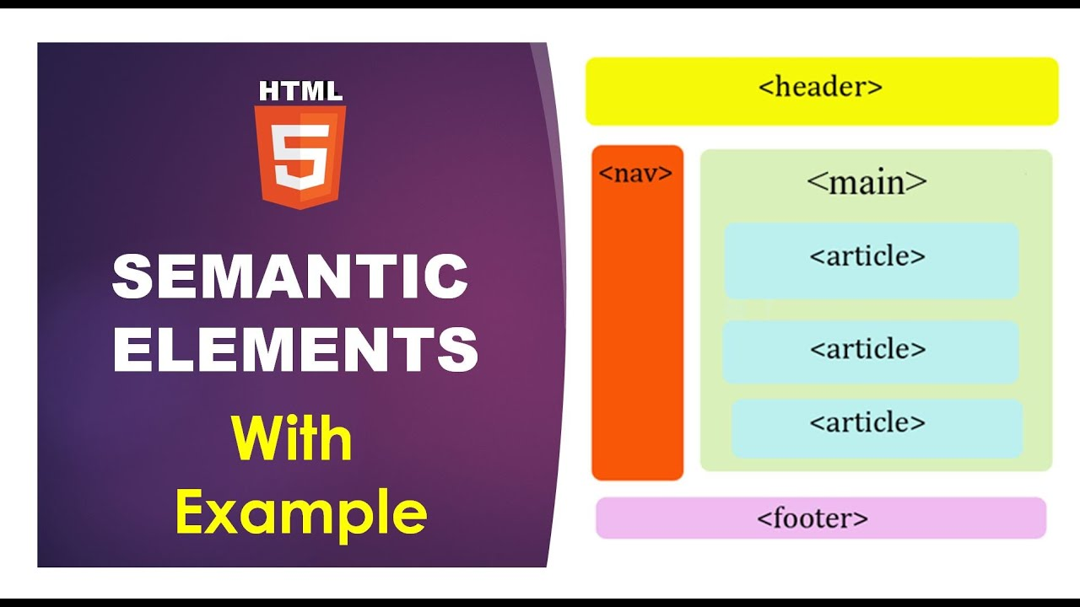
HTML5 Semantic Elements
Semantic elements in HTML5 provide more meaning to the content.
Examples include <header>, <nav>, <article>, and <footer>.
They help improve accessibility and SEO of the webpage.
Notes:
Image source: https://www.youtube.com/watch?v=0qfWqsKrZ04

Slide 7
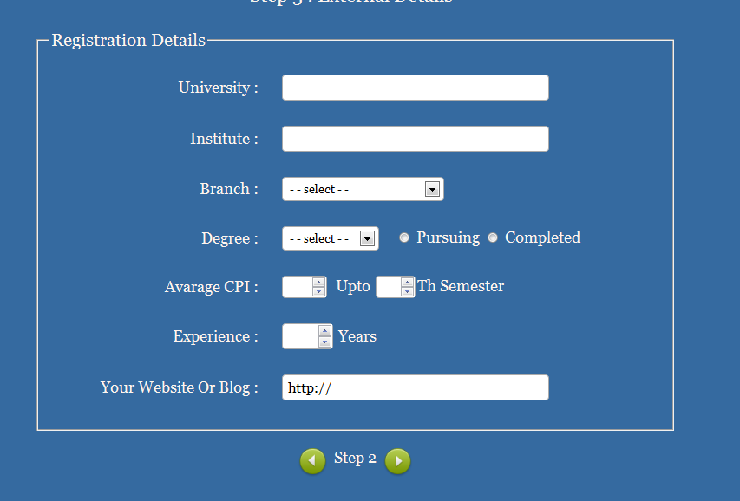
Forms in HTML
HTML forms allow users to interact with the webpage.
Form elements like <input> and <button> are used to collect user input.
Form validation can be implemented using HTML5 attributes.
Notes:
Image source: https://bedsbelx.blogspot.com/2021/06/registration-form-in-html-html.html

Slide 8
Multimedia in HTML5
HTML5 introduced native support for audio and video elements.
The <audio> and <video> tags make it easy to embed multimedia content.
Attributes like controls and autoplay enhance the user experience.
Notes:
Image source: https://www.tutorialbrain.com/html_tutorial/html5_audio/

Slide 9
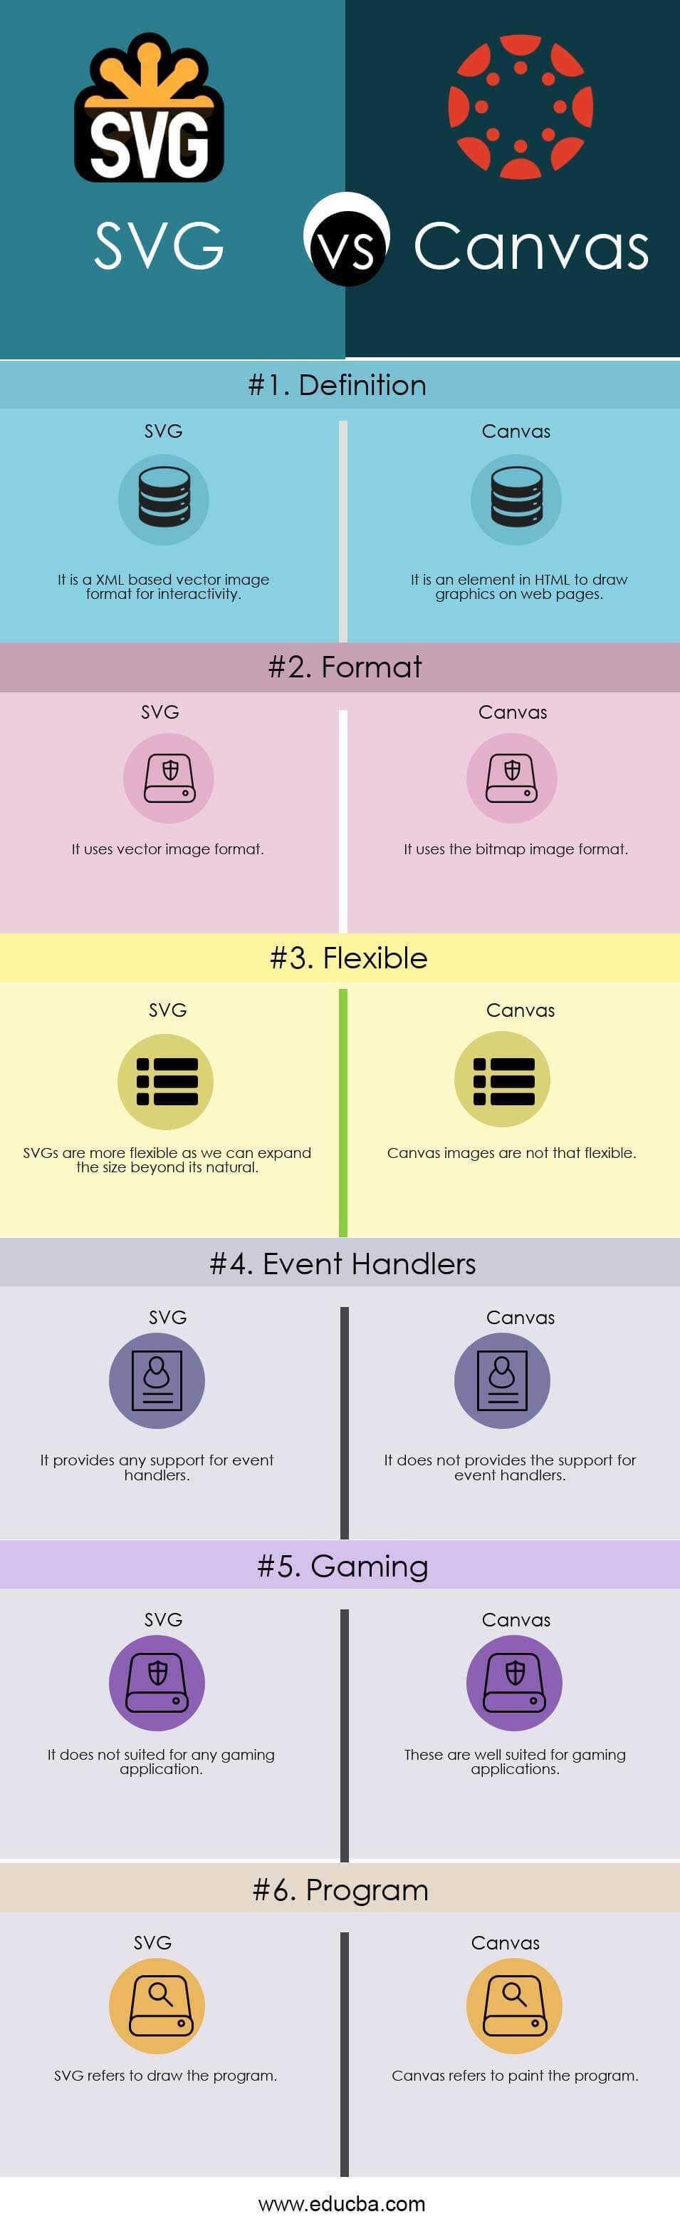
Canvas and SVG in HTML5
HTML5 Canvas allows for dynamic, scriptable rendering of graphics.
Scalable Vector Graphics (SVG) provide resolution-independent images.
Canvas is ideal for games and interactive animations.
Notes:
Image source: https://ar.inspiredpencil.com/pictures-2023/html5-canvas-infographic

Slide 10

Geolocation and Local Storage
HTML5 Geolocation API enables location-based services in web applications.
Local Storage allows storing data on the client's browser.
These features enhance user experience and functionality.
Notes:
Image source: https://discourse.opengenus.org/t/working-with-device-location-using-html-geolocation-api/3674

Slide 11

Accessibility in HTML5
HTML5 provides features like ARIA roles for improved accessibility.
Semantic elements help screen readers interpret content accurately.
Alt attributes for images enhance accessibility for visually impaired users.
Notes:
Image source: https://dev.to/robotcherries/html5-aria-attribute-explained-2kdi

Slide 12

Responsive Web Design
HTML5 and CSS3 support responsive web design techniques.
Media queries allow adjusting layout based on device screen size.
Responsive design ensures optimal user experience across devices.
Notes:
Image source: https://www.tutorialspoint.com/market/course/responsive-web-development-with-html5-and-css3-for-beginners/index.jsp

Slide 13

SEO Best Practices with HTML
Proper use of HTML elements like <title> and <meta> tags improves SEO.
Structured data markup helps search engines understand content.
Semantic HTML5 elements contribute to better search engine rankings.
Notes:
Image source: https://www.realguestbloggers.com/10-seo-best-practices-2020/

Slide 14
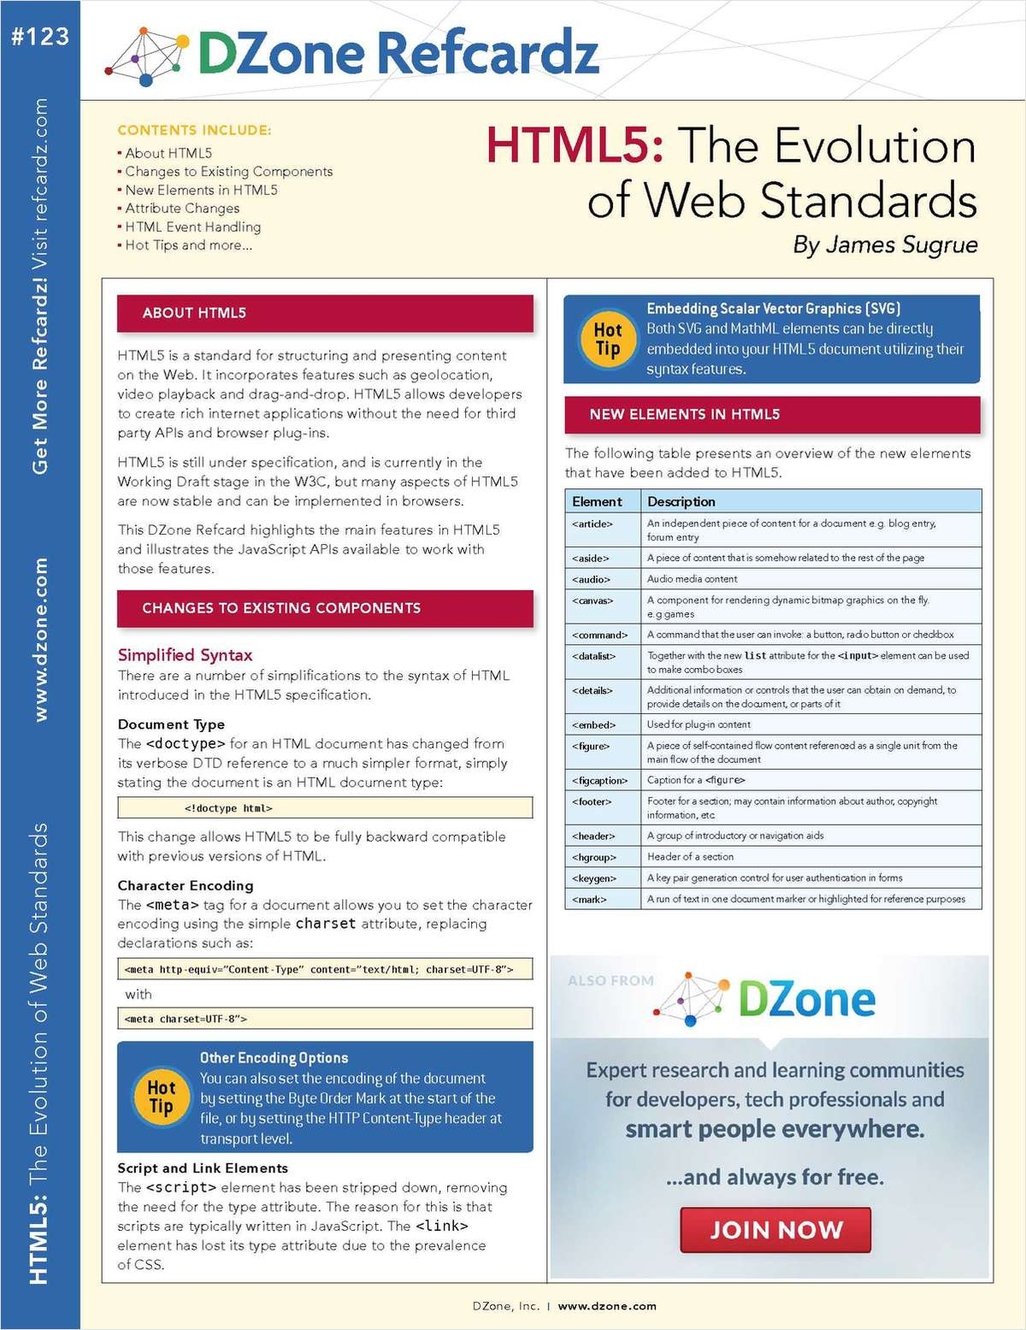
Web Standards Compliance
HTML5 adheres to web standards set by W3C.
Compliance with standards ensures cross-browser compatibility.
Valid HTML code improves website performance and accessibility.
Notes:
Image source: https://makeuseof.tradepub.com/free/w_dzon12/prgm.cgi

Slide 15
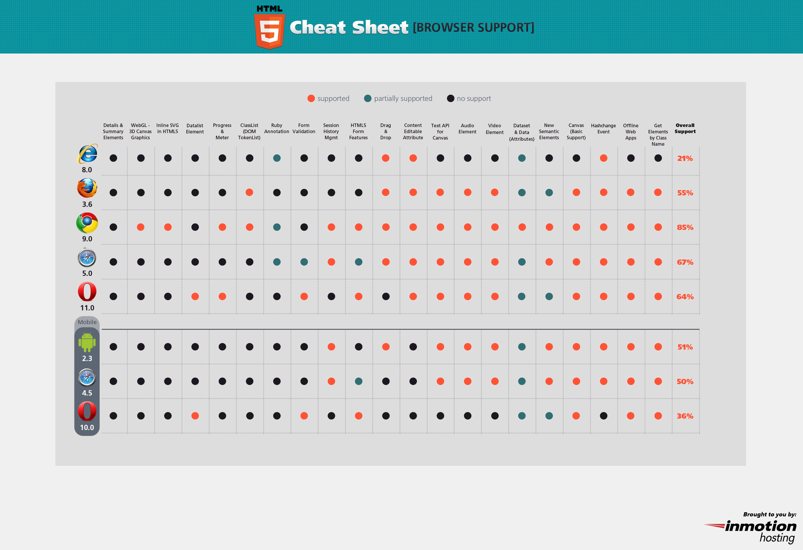
Browser Support for HTML5
Major modern browsers support HTML5 features.
Browser vendors regularly update their software to adopt new standards.
Feature detection techniques can be used to provide fallbacks for older browsers.
Notes:
Image source: http://infographicsmania.com/html5-browser-support-cheat-sheet/

Slide 16
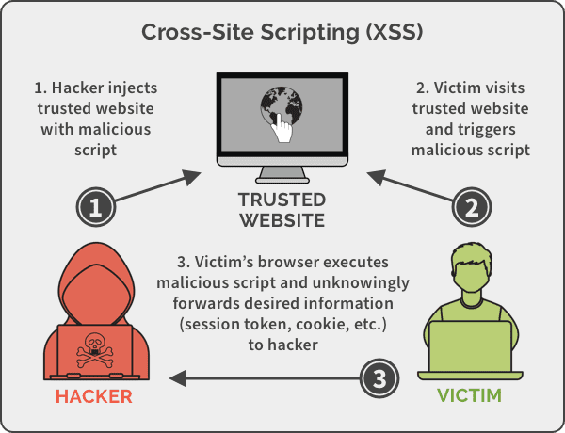
Security Considerations in HTML
Cross-site scripting (XSS) vulnerabilities can be mitigated with proper HTML encoding.
Content Security Policy (CSP) headers help prevent malicious scripts.
Secure coding practices should be followed to protect against attacks.
Notes:
Image source: https://securityboulevard.com/2019/05/cross-site-scripting-xss-web-based-application-security-part-3/

Slide 17
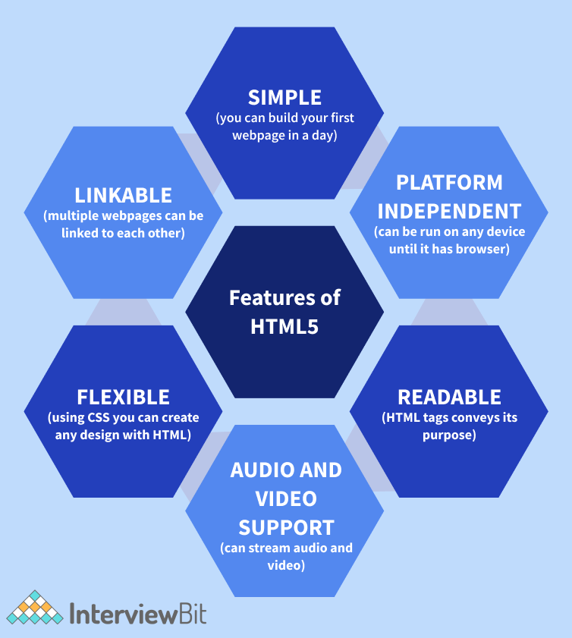
HTML5 Features for Mobile Development
HTML5 offers features like touch events and device orientation APIs for mobile development.
Progressive Web Apps (PWAs) leverage HTML5 capabilities for offline access and push notifications.
Mobile-first design principles can be implemented using HTML5 and CSS3.
Notes:
Image source: https://www.interviewbit.com/blog/html5-features/

Slide 18
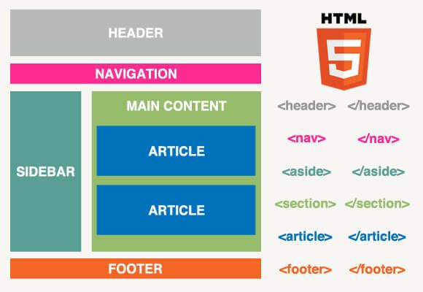
Web Components and Custom Elements
HTML5 supports web components for building reusable UI elements.
Custom Elements API allows creating custom HTML elements.
Shadow DOM provides encapsulation for styling and behavior isolation.
Notes:
Image source: https://br.pinterest.com/pin/567101778070416683/

Slide 19

Enhancements in HTML5.1 and Beyond
HTML5.1 introduced new elements and attributes for improved accessibility.
Ongoing developments in HTML aim to enhance web standards and user experience.
Features like WebAssembly and Web Components are shaping the future of web development.
Notes:
Image source: https://logodownload.org/html-5-logo/html5-logo-1/

Slide 20
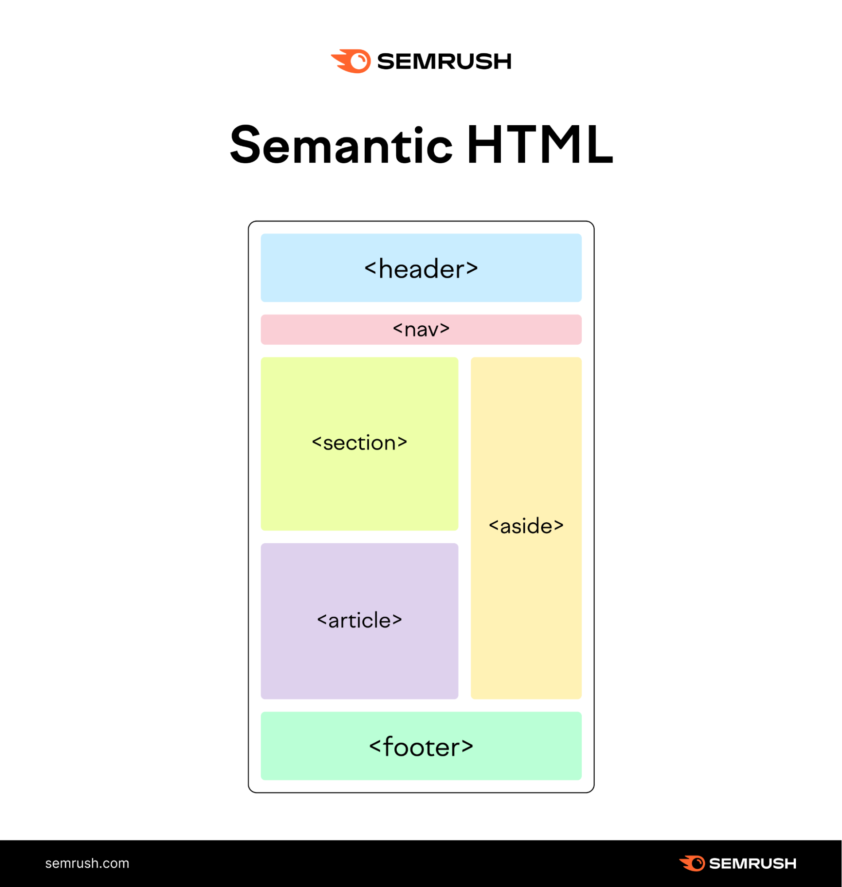
Best Practices for HTML Development
Use semantic HTML elements for better structure and accessibility.
Optimize images and multimedia content for faster loading times.
Keep code clean and well-commented for easier maintenance and collaboration.
Notes:
Image source: https://reviewguruu.com/2022/12/02/semantic-html-what-it-is-and-how-to-use-it-correctly/

Slide 21
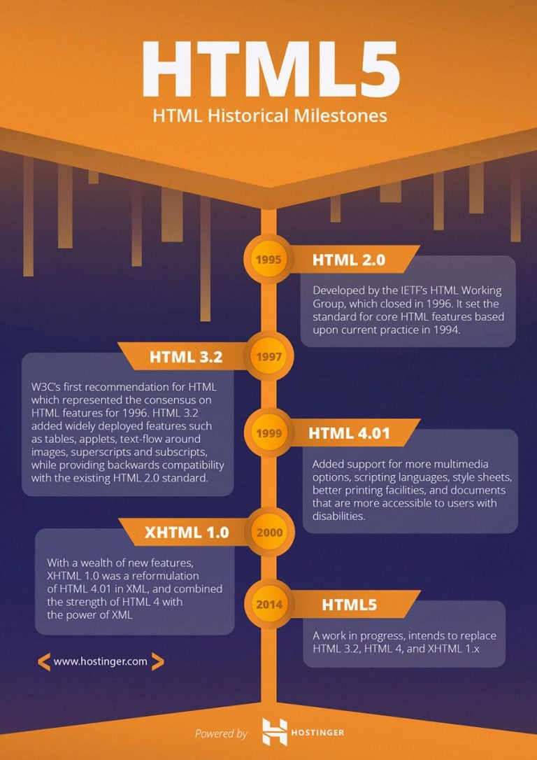
Conclusion
HTML and HTML5 are essential technologies for web development.
Understanding HTML fundamentals and new features in HTML5 is crucial for modern web projects.
Continuously learning and adapting to evolving web standards is key for successful web development.
Notes:
Image source: https://www.hostinger.my/tutorials/difference-between-html-and-html5

Slide 22
References
Mozilla Developer Network. (n.d.). HTML: HyperText Markup Language. https://developer.mozilla.org/en-US/docs/Web/HTML
Your second bullet
Your third bullet

